Slide 1
Differential expression
July 1st,2017
Yulong Li

Slide 2
Starting log2 data([6,8]VS[10,4,5])
ProbeName | [ESCC-1](normalized) | [ESCC-2](normalized) | [ESCC-3](normalized) | [ESCC-4](normalized) | [ESCC-5](normalized) | [ESCC-6](normalized) | [ESCC-7](normalized) | [ESCC-8](normalized) | [ESCC-9](normalized) | [ESCC-10](normalized) | ESCC-1 | ESCC-2 | ESCC-3 | ESCC-4 | ESCC-5 | ESCC-6 | ESCC-7 | ESCC-8 | ESCC-9 | ESCC-10
ASHGV40014820 | 7.218976 | 4.615666 | 4.897312 | 6.660559 | 6.29878 | 6.421718 | 4.757763 | 6.43397 | 6.058734 | 5.591959 | P | P | P | P | P | P | P | P | P | P
ASHGV40009737 | 11.12363 | 11.03689 | 9.491639 | 10.88006 | 11.08742 | 11.38872 | 10.54311 | 10.67556 | 10.78327 | 10.22059 | P | P | P | P | P | P | P | P | P | P
ASHGV40021163 | 11.05372 | 10.46049 | 11.28169 | 10.04441 | 10.7257 | 10.35948 | 10.14851 | 11.26608 | 10.41499 | 11.26785 | P | P | P | P | P | P | P | P | P | P
ASHGV40015652 | 7.801934 | 6.682509 | 8.612273 | 8.469833 | 8.925277 | 8.217594 | 7.360525 | 7.778667 | 8.018102 | 8.958987 | P | P | P | P | P | P | P | P | P | P
ASHGV40020595 | 3.67145 | 5.625205 | 5.348752 | 4.707802 | 2.806892 | 3.567373 | 4.308878 | 2.362095 | 4.258205 | 5.124921 | A | P | P | P | A | A | A | A | P | P
ASHGV40006284 | 12.68796 | 13.54097 | 16.34193 | 13.99314 | 13.76454 | 13.28207 | 13.36937 | 14.2887 | 14.43438 | 14.52688 | P | P | P | P | P | P | P | P | P | P
ASHGV40043175 | 8.952357 | 9.888378 | 7.98767 | 9.51695 | 8.740396 | 9.091001 | 8.138377 | 9.248814 | 8.902634 | 9.355901 | P | P | P | P | M | P | P | P | P | P

Slide 3
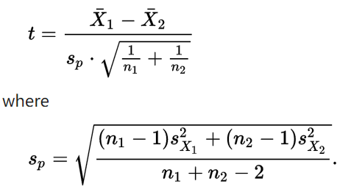
Identifying differentially expressed genes
Calculate fold change
log(A / B) = log(A) - log(B)
Calculate p-value
Student’s t-test
Filter out questionable expression levels
At least one sample is ‘Present’
Calculating FDR corrected p-value
p.adjust(pvaluelist,method=‘fdr’)

Slide 4
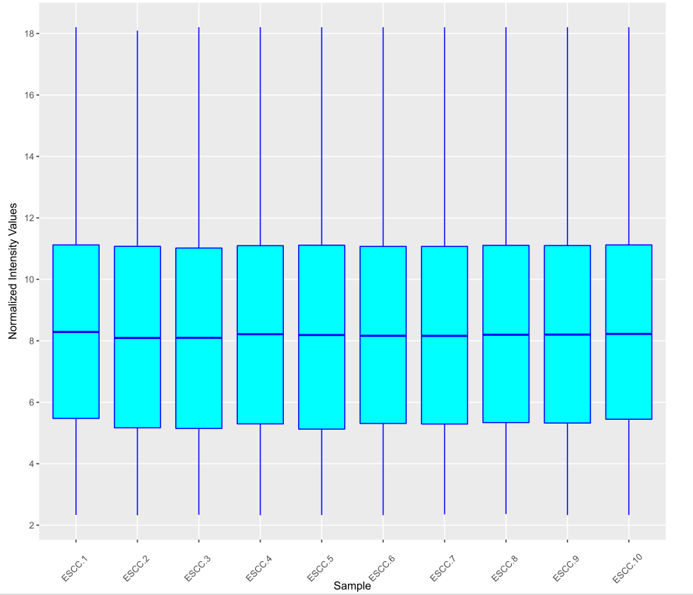
Boxplot

Slide 5
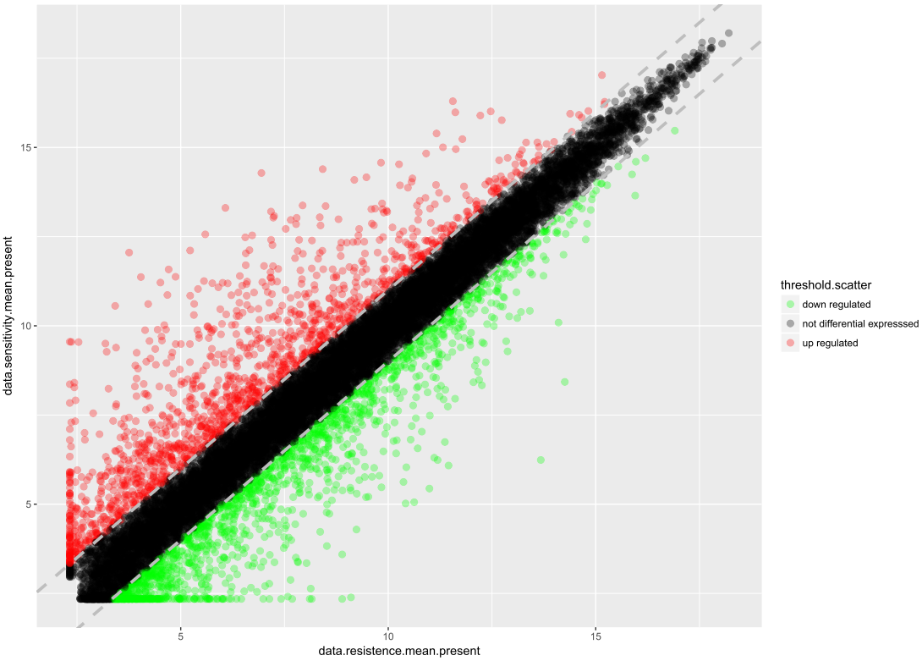
scatter

Slide 6
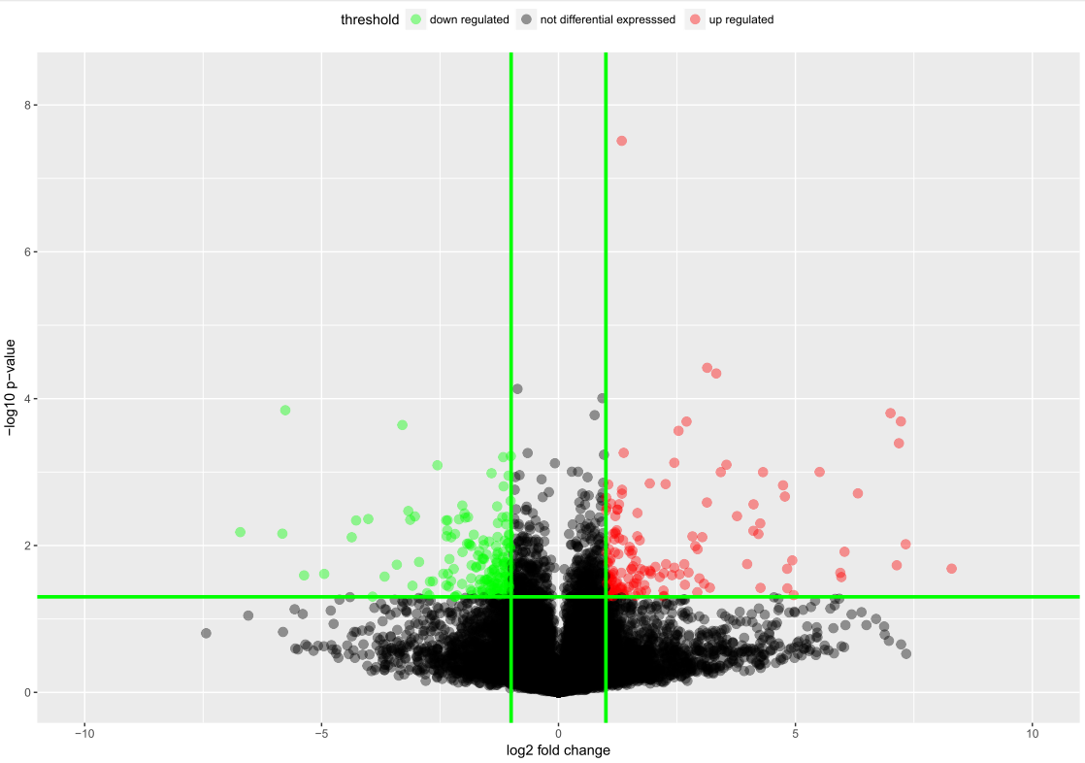
Vocano plot

Slide 7
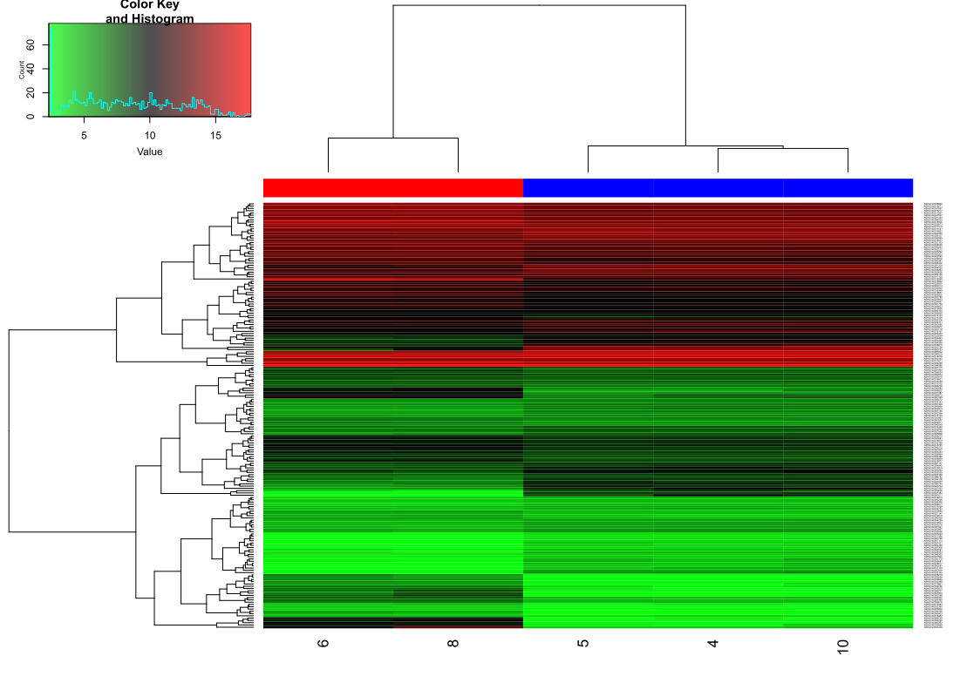
Heatmap for differential expressed genes

Slide 8
Concerns
They use student’s t-test to calculate the p-value,
the alternative option is to use Welch’s t-test. The difference is that the student’s t-test assumes similar variance in both samples.
Apart from hypothesis testing, there are other ways to identify the differential expressed genes.
SAM, LIMMA, characteristic direction…
The characteristic direction: a geometrical approach to identify differentially expressed genes. BMC Bioinformatics 2014 15:79.

